Slide 1

CAR CARE
“
Submitted By:
Akshay Anish
22PMC104

Slide 2

ABSTRACT
Car Care is a vehicle service management system web app. Developed using Python Django and SQLite database. Customers can submit requests and view progress. Administrators manage mechanics and assign jobs. Mechanics can view and update their work. Car Care aims to simplify the process and improve customer satisfaction.

Slide 3

PROJECT REQUIREMENTS
User registration for Customers And login functionality for all users
Customer can request for Service
Customer can view Status
Customer can view the cost
Customer can Send feedback
Admin can add mechanics
Admin can approve service request and Job Assign to Mechanic
Admin can update service status
Admin can view customer’s, mechanics and feedback
Mechanic can view work assigned
Mechanic can update the status
Mechanic can send feedback according to the work what all are repaired
“

Slide 4

FEATURES AND HIGHLIGHTS OF THE PROJECT
User Registration and Login
Service Request Submission
View Status
Cost Estimation
Feedback Submission
Administrative Control
Mechanics Work Management
User-friendly Interface

Slide 5

TECHNICAL ASPECTS
Presentation layer:
The presentation layer includes the UI, Django templates, Jazzmin package, and Chartjs. The UI interacts with users. Django templates render dynamic content. Jazzmin provides an interactive admin panel. Chartjs provides interactive charts for analytics.
Application layer:
The application layer includes Django and Django Views. Django handles HTTP requests and manages the app's logic. Django Views receive requests, process data, and generate responses. They interact with models, services, and external APIs.

Slide 6
CHALLENEGES FACED
“
User Experience and User Interface:
Designing a user-friendly interface for Car Care is important but can be challenging. To overcome this, conduct user research, gather feedback, and make improvements based on user input. Ensure the interface is easy to use, responsive to different devices, and accessible to all users.
Coding the logic
Coding the logic behind Car care were really difficult. It was completed after days of coding and getting help from friends
Security and Authentication:
Implementing security measures for Car Care to protect user data, prevent unauthorized access, and ensure secure authentication can be challenging due to the need for encryption, authentication protocols, and access controls.

Slide 7
FUTURE ENHANCEMENTS
Mobile Application:
A mobile app version of the system can enhance accessibility and convenience. Customers, administrators, and mechanics can manage requests and provide feedback on the go.
Integration with Payment Gateways:
Integrating secure payment gateways can enable online payments for services, providing a seamless experience.
Service Reminder Notifications:
A feature that sends automated service reminders can help customers stay proactive in servicing their vehicles and ensure timely maintenance.

Slide 8

CONCLUSION
The project was completed successfully within the given time. Each module was tested individually and then integrated into the main system. We also conducted tests using real data, and everything worked smoothly. As a result, the system has achieved all the goals we set out to accomplish. Our aim of creating this car care system has been fulfilled, and we are pleased with the outcome.

Slide 9

REFERENCES
https://phpgurukul.com/vehicle-service-management-system-using-php-and-mysql/
https://www.youtube.com/watch?v=WrZ10AZYbv4&list=RDCMUC7dD1bOWXiJH3lJLsTInxOQ&start_radio=1&rv=WrZ10AZYbv4&t=0
https://docs.djangoproject.com/en/4.2/
https://django-jazzmin.readthedocs.io/

Slide 10
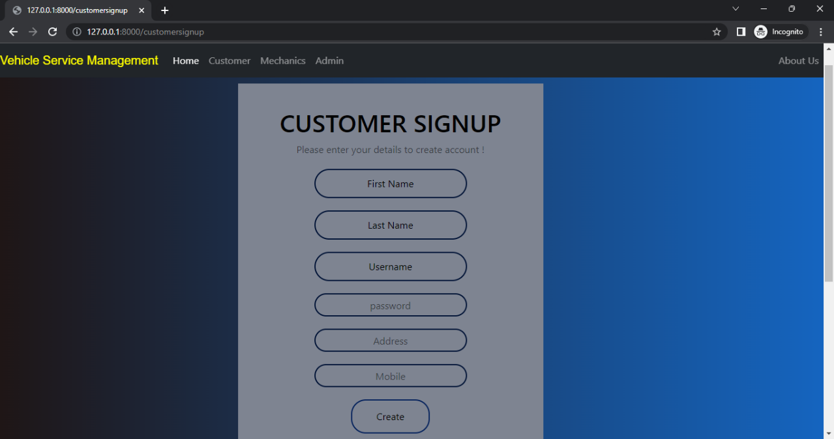
SCREEN SHOTS
CUSTOMER
SIGN UP

Slide 11
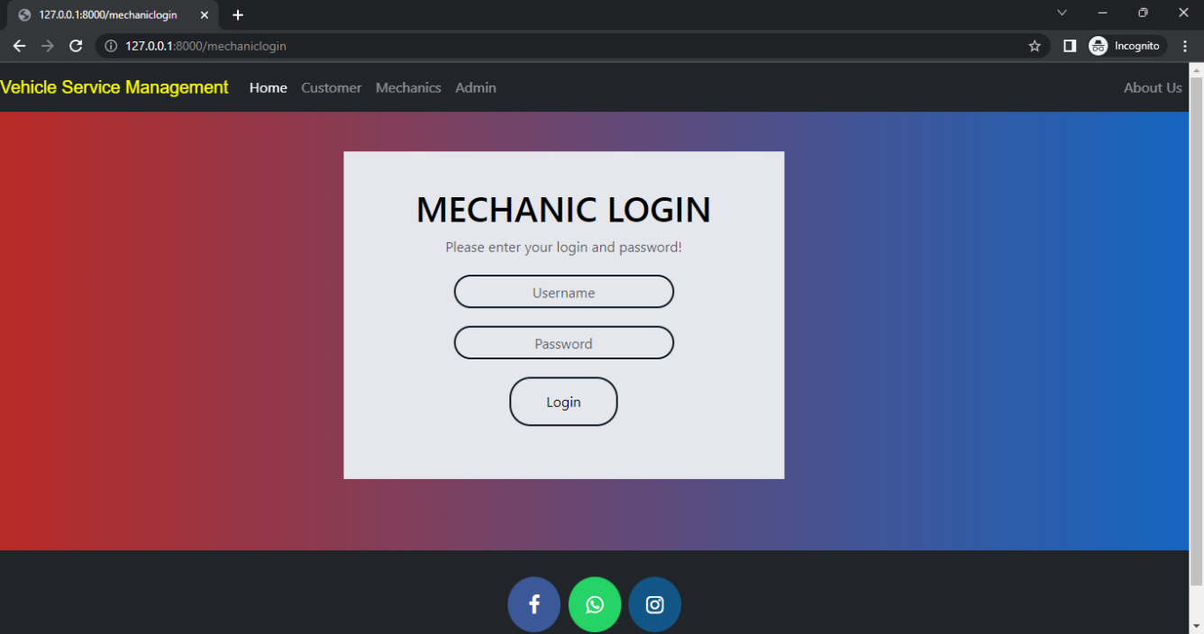
MECHANIC LOGIN

Slide 12
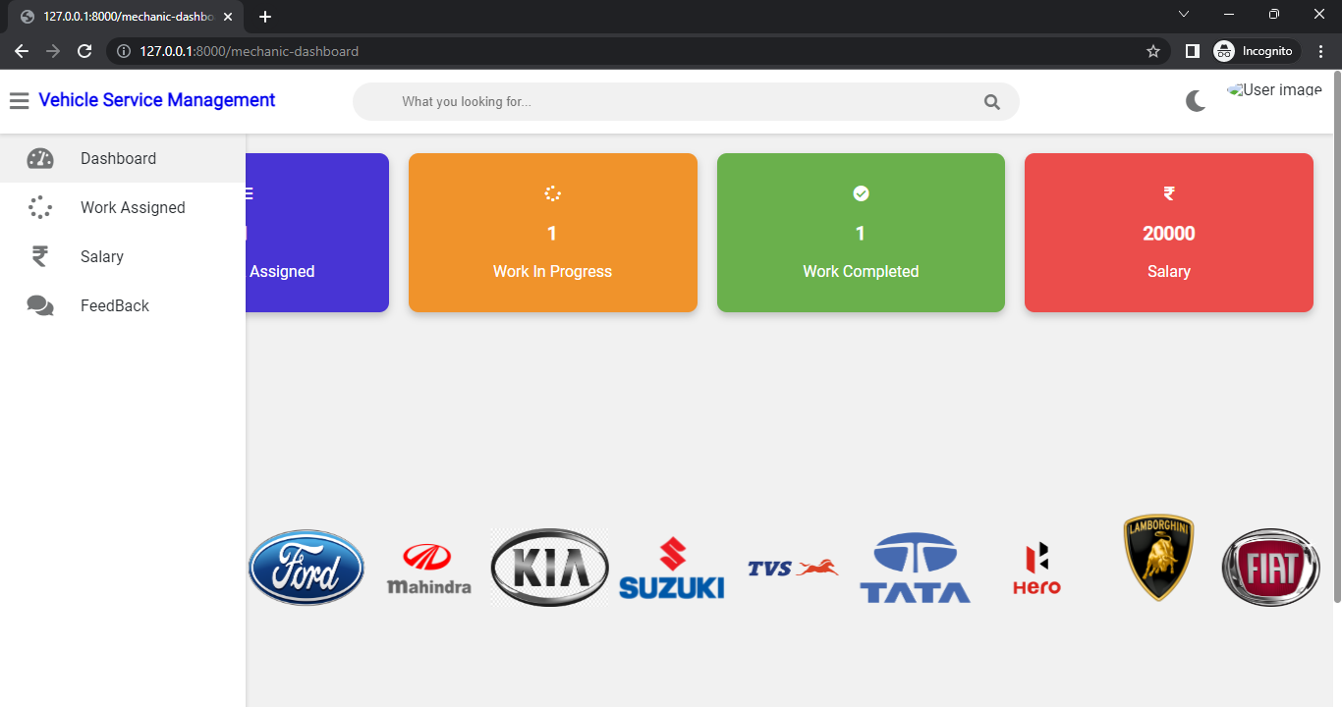
MECHANIC DASHBOARD

Slide 13
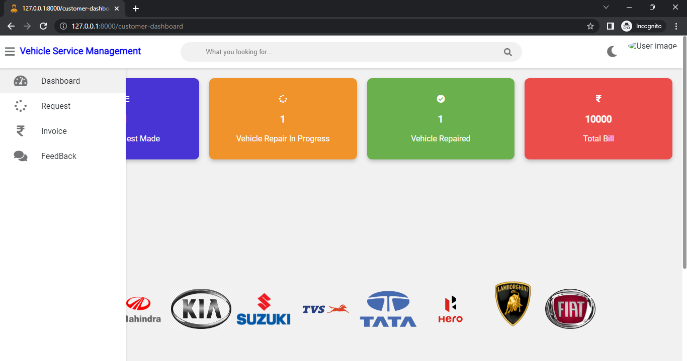
CUSTOMER DASHBOARD

Slide 14
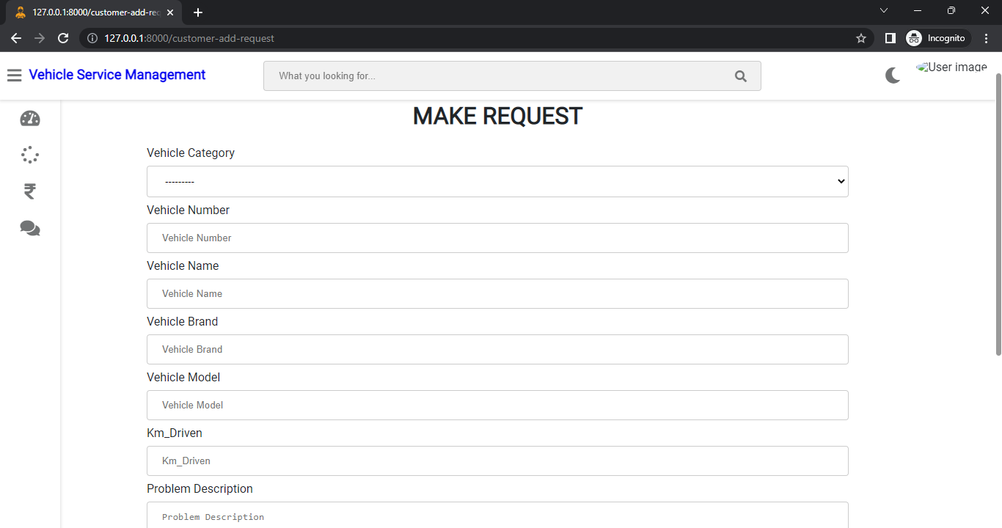
CUSTOMER REQUEST

Slide 15
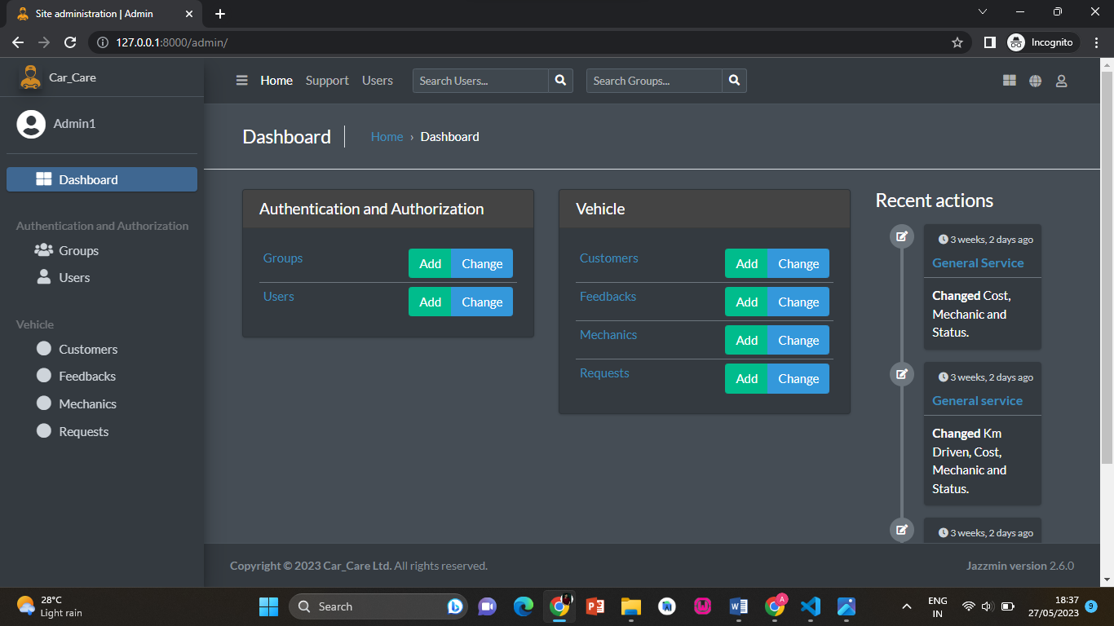
ADMIN DASHBOARD

Slide 16

THANK YOU!
“

